Slide 1
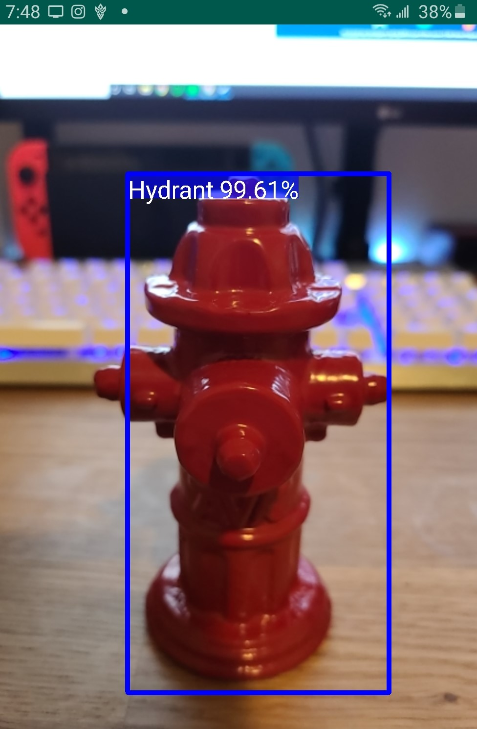
An American AVK Automation
UNR CSE Team 29: Benjamin Estela | Sidney Inouye | Lan Le | Wen Ruan Instructors: Dr. Sergiu Dascalu and Devrin Lee, UNR CSE Department Advisors: Anne Paine, American AVK
CSE
Abstract
User Interface
Future Work
Our team paired up with AVK, a fire hydrant manufacturing company, in order to provide them with a fire hydrant detection application. The team implemented an augmented reality mobile application that uses image recognition technology to identify fire hydrants, which then displays maintenance manuals, as shown in Figure 2, to ease the process of troubleshooting hydrants for maintenance workers out on the field. To further improve the accuracy of the image recognition algorithm, GPS coordinates are used to map locations of hydrants and confirm results from the image recognition algorithm. An application like this greatly reduces time out on the field for technician workers, which allows them to perform hydrant maintenance on a larger scale.
The future of this application will be dependent on the feedback from the users. We have already acknowledge some additions to the application such as a recently viewed page, hydrant distance calculator, and shortest path navigation. The smaller issues that could be seen in future renditions would be an IOS version as well as standardized UI for both mobile OS systems.
Hydrant detection and recognition accuracy shown in Figure 3 will also be one of the biggest ongoing developments as it will reduce the chances of error on the field for the users.
Fig. 1: The GPS map shows hydrants as markers.
Fig. 3: The detection of a sample fire hydrant
Conclusions
We paired up with AVK in order to provide them with a fire hydrant detection application. Through the uses of mobile development and machine learning technology, we hope to have created an application that will help out field technician workers with identifying fire hydrant models. This application will help not only the field workers but also the companies by improving efficiency and errors handling.
Main Goals
Fig. 2: The app displays manuals as an in-app PDF reader.
Our goal as a team was to develop a mobile application to recognize fire hydrants using a camera that was widely accessible to all users. Using the application the user can then pull up maintenance manuals for the scanned hydrant providing them easy access to all company documents. We further wanted to help the field workers by providing a hydrant location service and mapping. All of these features we hope will increase work efficiency and safety.
Architecture and Design
The application was developed as four components which were connected together at the end, they consist of the UI, GPS features as shown in Figure 1, the database, the object detection model. All the UI and GPS functionalities were written using Java and developed in Android Studio. The database was created using SQLite and tied together using Android Studio. The object detection model was developed and trained using TensorFlow, which was then converted to mobile viewing using TensorFlow Lite. The modules were all tied in using native Android Studio.
Acknowledgements
We would like to thank our professors Sergiu Dascalu and Devrin Lee for providing amazing feedback during the development process. Also we would like to give our thanks to Anne Paine, our external advisor from AVK, for giving us the opportunity to work on this application.
This project was developed in Spring 2020 as part of the course CS 426 Senior Projects in Computer Science.
Notes:
Using the given 36x48 Poster Template
Header: Has everything needed.
Body:
Abstract - done
Description (goals, features, and architecture)
goals done
features
architecture
Future Work (3 directions)
Conclusions
Acknowledgements (Optional)
Main references (Optional)
Footer: Has everything needed.

